Slide 1

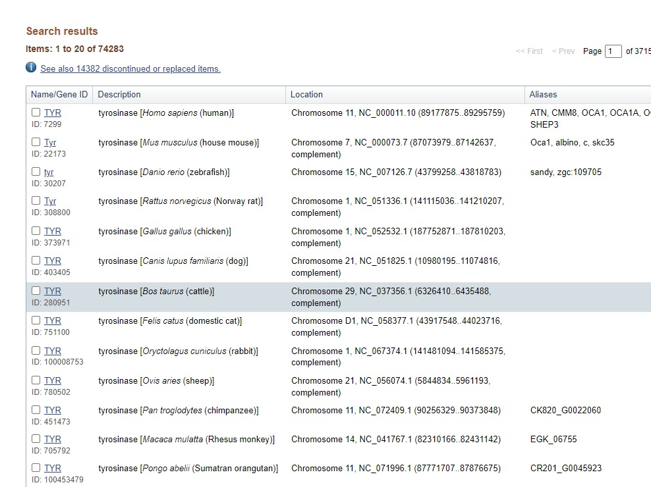
Predicting the abundance of TYR genes in bacteria based on Metagenomics and Machine Learning
Genomics
1.Data: Genomics
2.Method: Multiple sequence comparison using MEGA X
Advantage：Ensure the presence of the main structure of the target protein = function exsit
Dis~ : Sequences need to be 96.5% or more identical to be considered a successful match.
&Long time taking = no enough sample for ML)
3.Limitation: Missing sequence!!!
Up to now, because of leaps and bounds in gene sequencing technology, extremely rich sequencing data has been collected, but not successfully annotated. The only way to use the genome for comparison is to use a fully annotated 'reference gene pool'.

Slide 2

Predicting the abundance of TYR genes in bacteria based on Metagenomics and Machine Learning
Genomics
1.Data: Metagenomics
2.Method: After filtering low quality data and aptamer
sequences, gene annotation based on known databases AGR abundance in ppm.
Using “Metaphlan”
Advantage：Quantitative short series comparison with PPM, fast and data-rich for subsequent random forest models.
Dis~ : Based on the macro-genome, the amount of data analysed is enormous.
3.Random Forest
130 sample-set（80% training 20% Validation）
Data size： 1TB

Slide 3
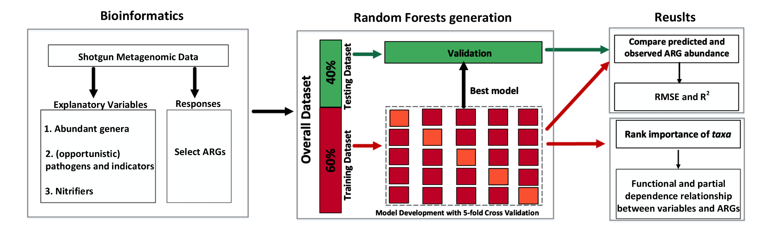
Predicting the abundance of TYR genes in bacteria based on Metagenomics and Machine Learning

Slide 4
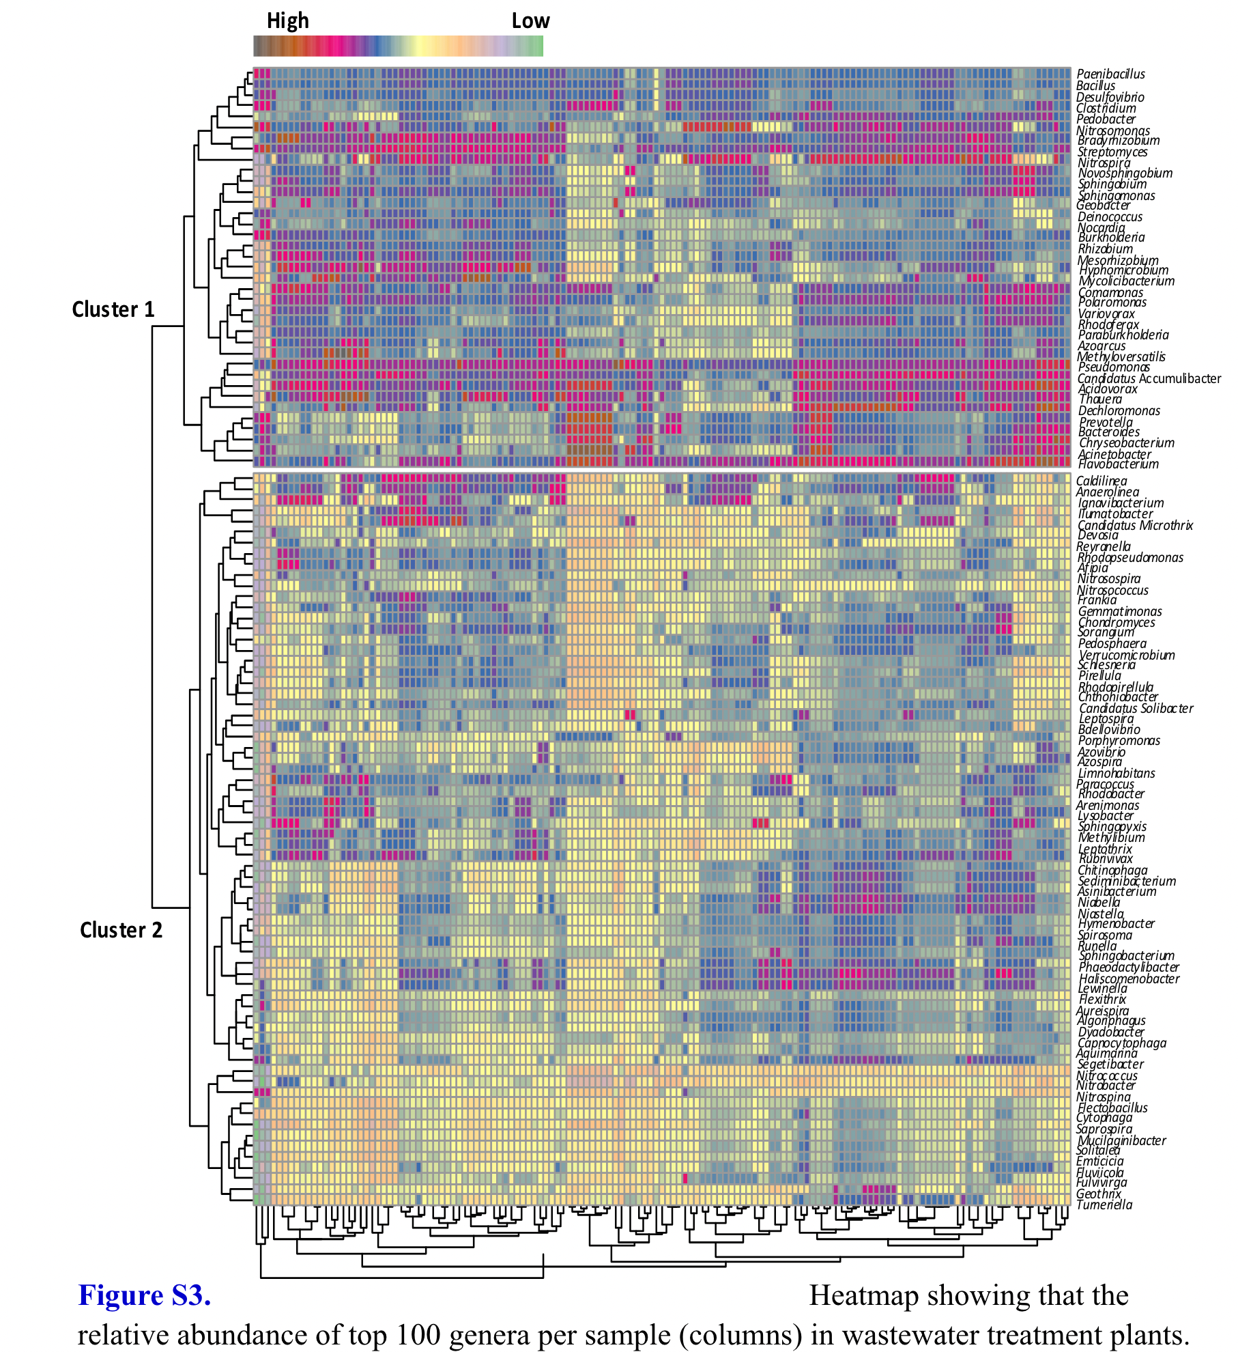
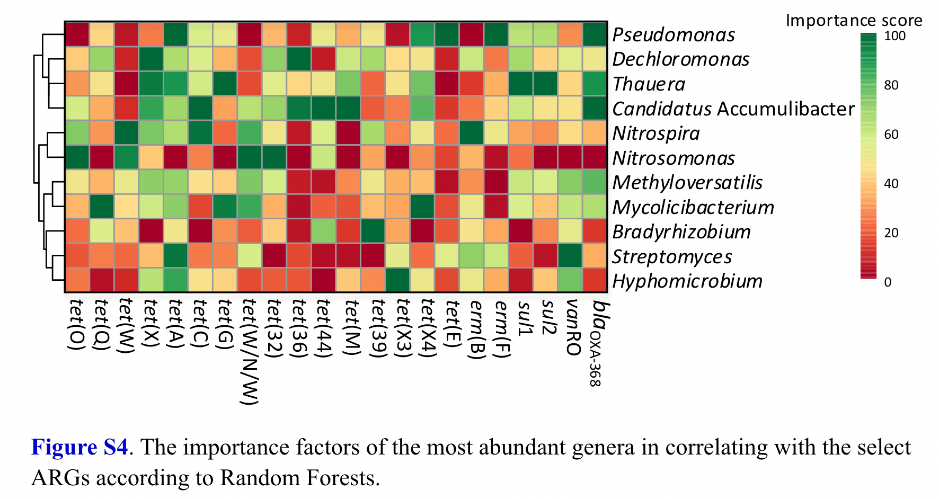
Predicting the abundance of TYR genes in bacteria based on Metagenomics and Machine Learning

Slide 5
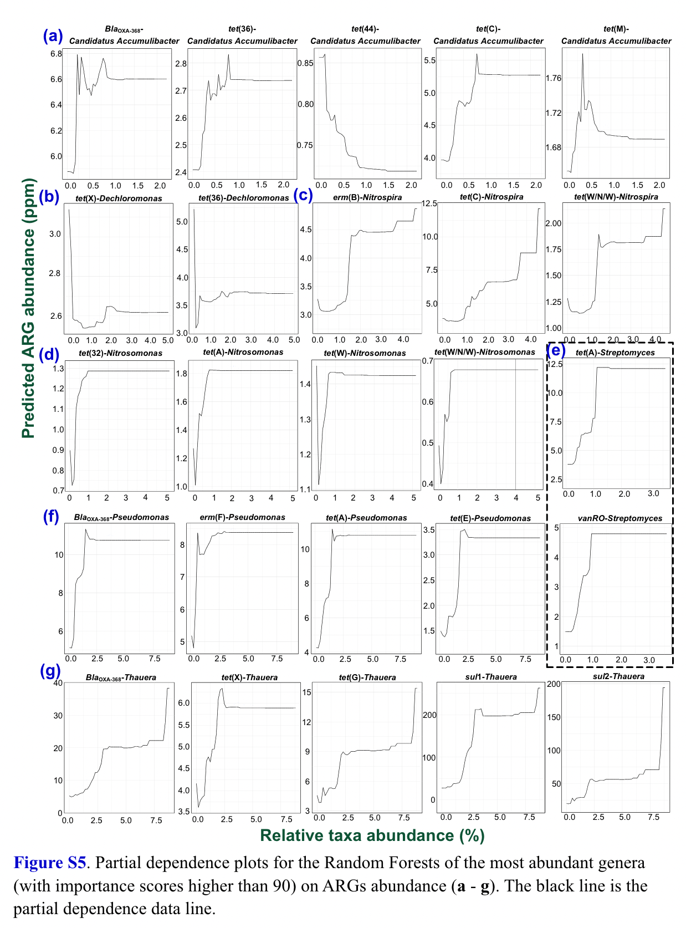
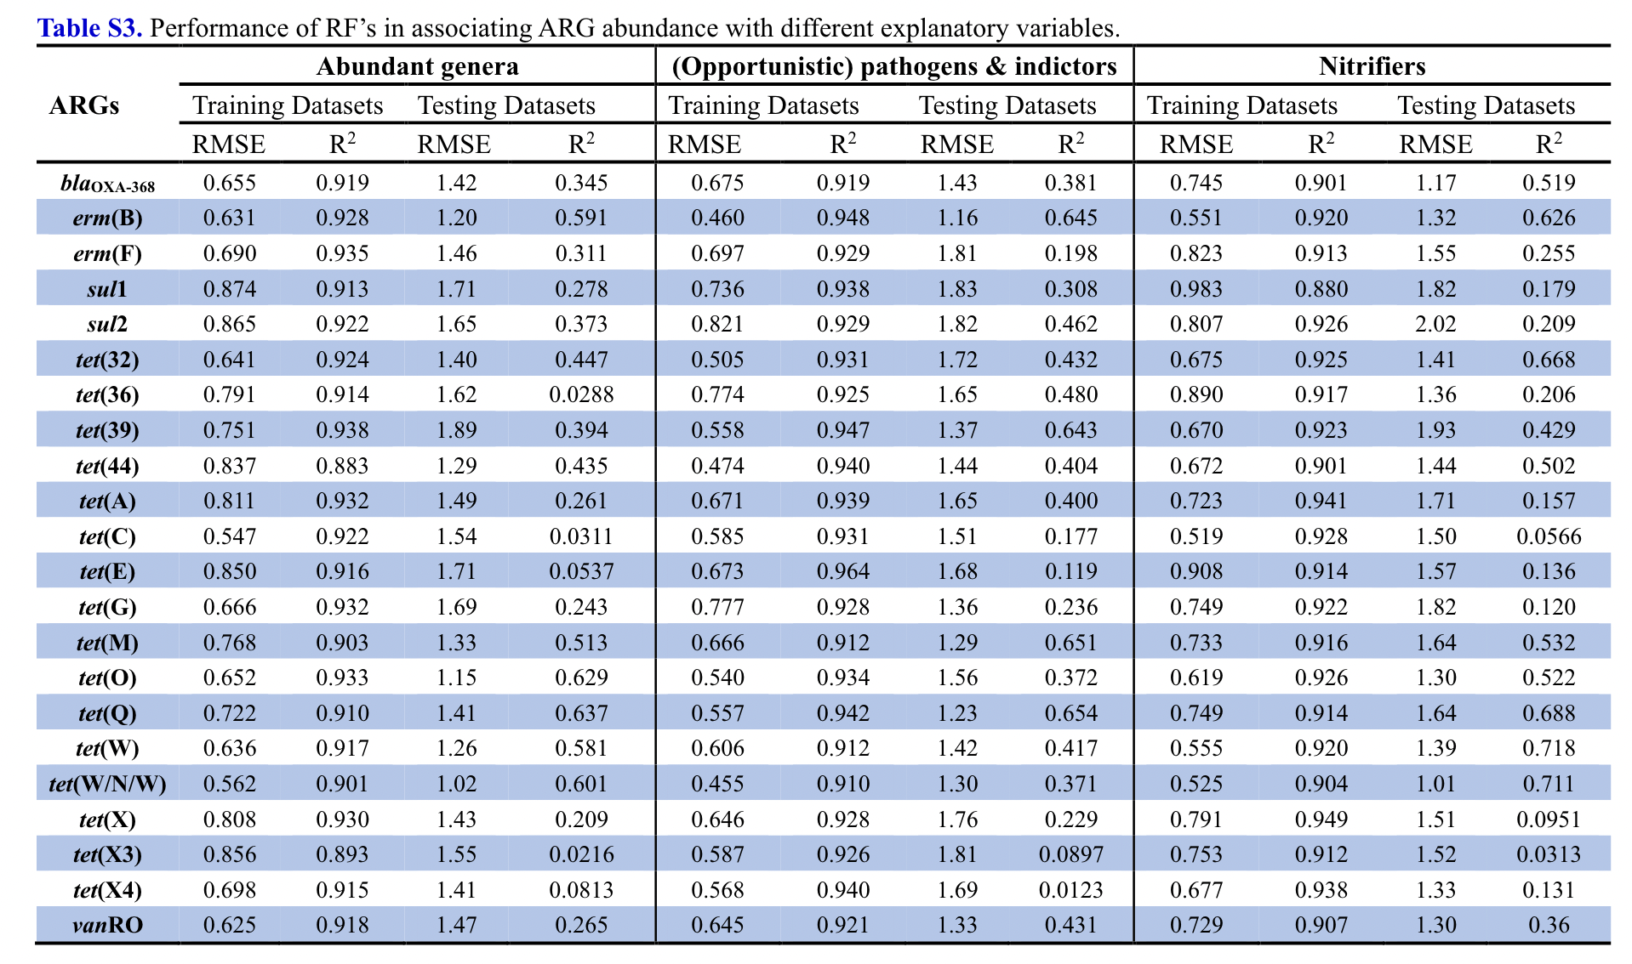

Slide 6
Predicting the abundance of TYR genes in bacteria based on Metagenomics and Machine Learning
Identification: Multiple evolutionary subspecies can exist in a single strain, and specific environmentally induced variation is more unique, so specific identification is not possible. However, potential TYR gene hosts can be identified by gene abundance and enrichment genes.

Slide 7
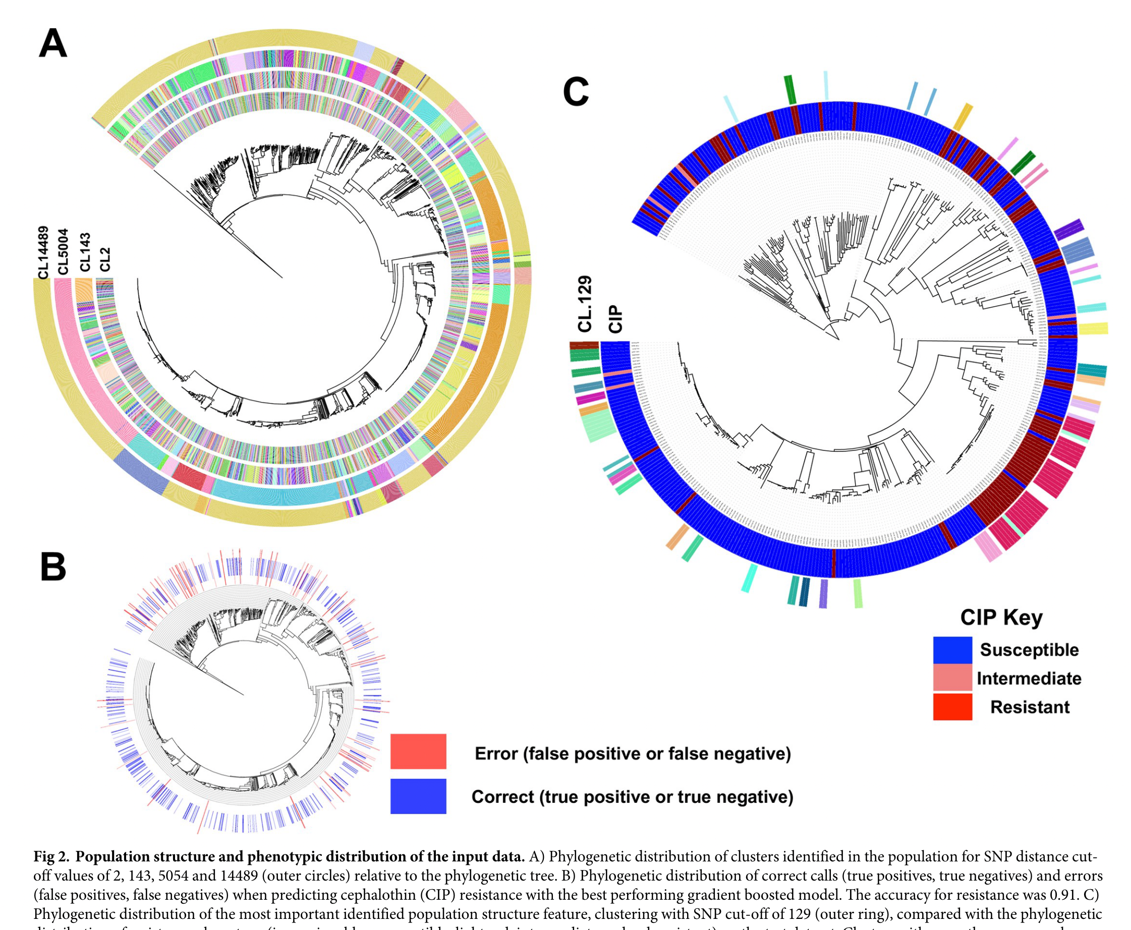

Slide 8
Predicting the abundance of TYR genes in bacteria based on Metagenomics and Machine Learning
Identification: Multiple evolutionary subspecies can exist in a single strain, and specific environmentally induced variation is more unique, so specific identification is not possible. However, potential TYR gene hosts can be identified by gene abundance and enrichment genes.
Compare： Compare the evolutionary tree of the input data with the gene tree of the enriched genes to infer to some extent the environment from which the bacterium evolved the function, validating？ it against the correlation factors verified in the random forest

